Slide 1
NYC Airbnb Data Analysis

Slide 2
Content
Problem Statement
Data Summary
Doing Basic Examination
Cleaning The Dataset
What Hosts And Areas Tell Us?
What Can We Find About Price and Listings?
The Busiest Host
Facts About Traffic
Challenges
Conclusion

Slide 3
Problem Statement
Airbnb, Inc. is an American vacation rental online marketplace company based in San Francisco, United States. The company has huge data of guests and hosts (Guesthouse/Hotel Owners) of New York City. This data can be analyzed and used to discover understandings such as:
What can we learn about different hosts and areas?
What can we learn from predictions? (ex: locations, prices, reviews, etc)
Which hosts are the busiest and why?
Is there any noticeable difference of traffic among different areas and what could be the reason for it?

Slide 4
Data Summary
First things first, let us go over the columns that we are going to need to solve the problem.
host_id
host_name
neighbourhood_group
neighbourhood
longitude
latitude
room_type
price
minimum_nights
reviews_per_month
calculated_host_listings_count

Slide 5
Doing Basic Examination
The dataset contains 48895 rows and 16 columns
Datatypes of various columns are integer, float and objects
There are some outliers and null values as well
Data cleaning steps required

Slide 6
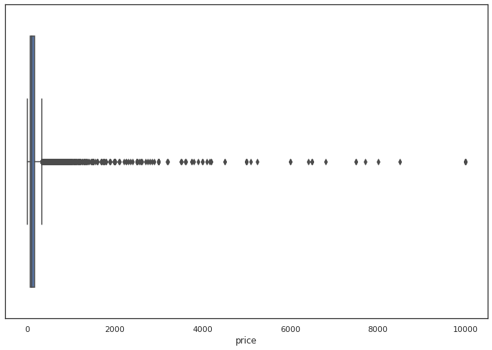
Cleaning The Dataset
Getting rid of outliers is the most crucial part of the project.
Checking for outliers in the price column.
Following is the box plot of the price column in original data set.
Minimum value = 0
Maximum value = 10000

Slide 7
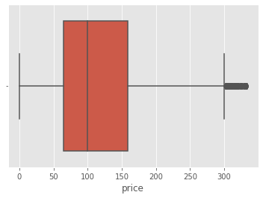
Attempt 1: Getting rid of outliers using percentile.
The following plot shows us the price column after removing outliers using IQR.

Slide 8
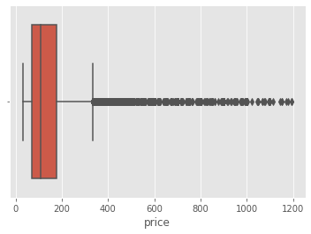
Attempt 2: Getting rid of outliers using quantiles.
The following plot shows us the price column after removing outliers using quantiles.

Slide 9
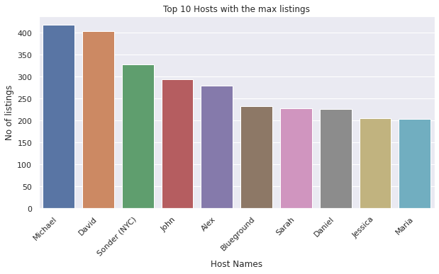
What Hosts And Areas Tell Us?
Top 10 hosts with maximum listings

Slide 10
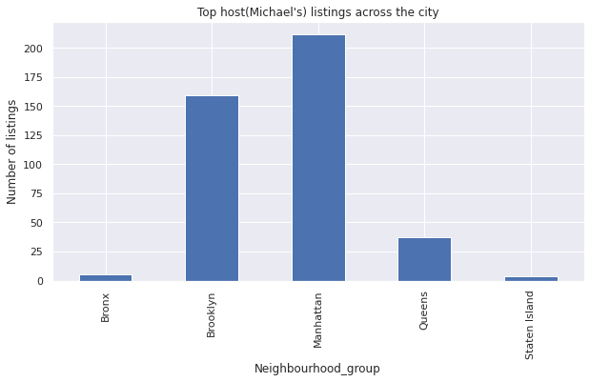
Let’s see where the top host has his listings throughout the city.

Slide 11
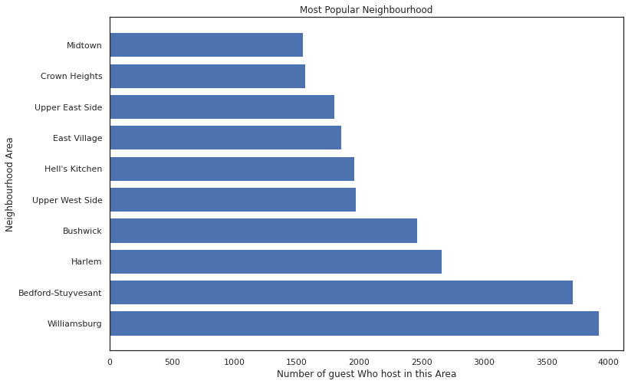
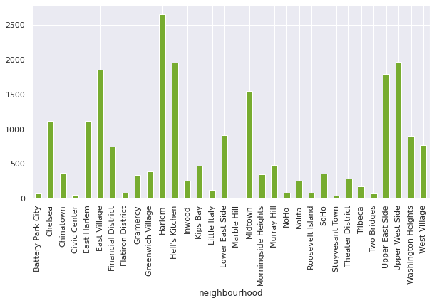
Find out which neighbourhood has most listings based on counts and name.
Harlem, Manhattan has the most listings.

Slide 12
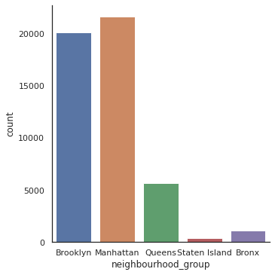
Most number of listings in a Neighbourhood Group.

Slide 13
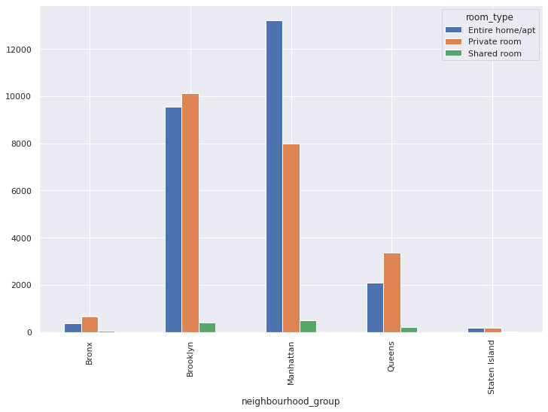
Room type in each individual Neighbourhood group.

Slide 14
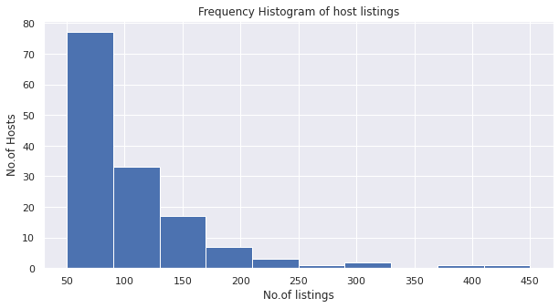
Frequency of various host listings

Slide 15
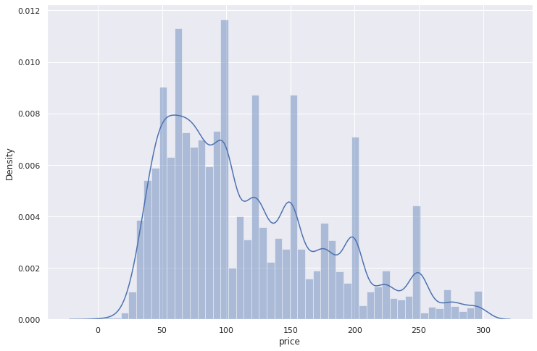
What Can We Find About Price And Listings?
Following histogram shows the distribution of price range across the city.

Slide 16
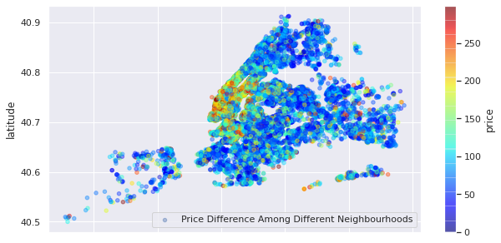
The following scatter plot depicts the price distribution for various neighbourhoods. We can infer that Manhattan has most listings in the average price range.

Slide 17
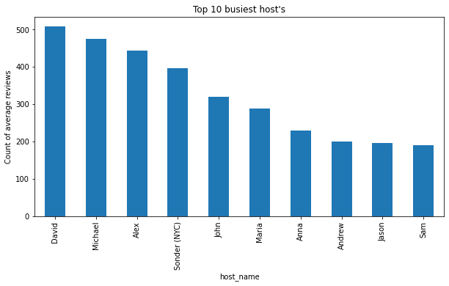
The Busiest Host
David is the busiest host with the average of 508 reviews per month

Slide 18
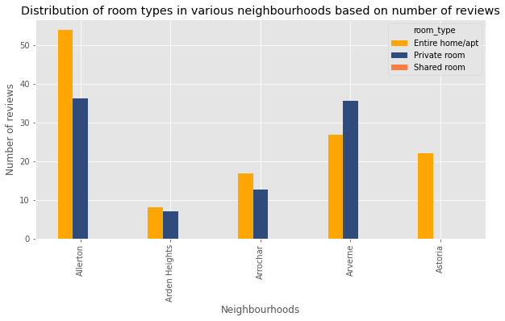
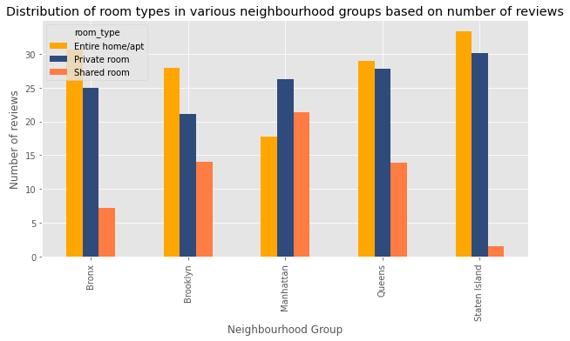
Facts About Traffic
Distribution of room types in various neighbourhood groups, neighbourhoods and their price range based on number of reviews.

Slide 19
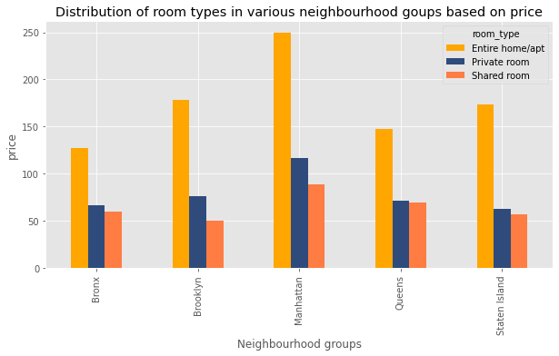
Distribution of room types in price range based on number of reviews.

Slide 20
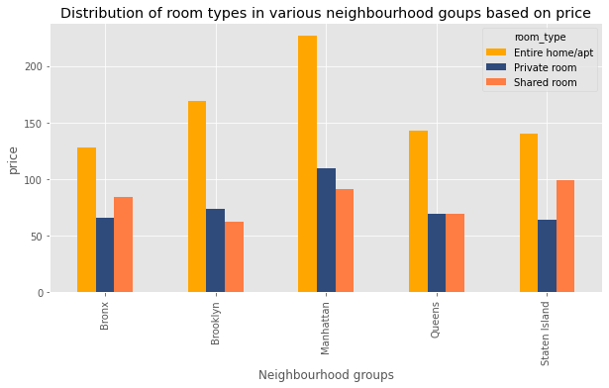
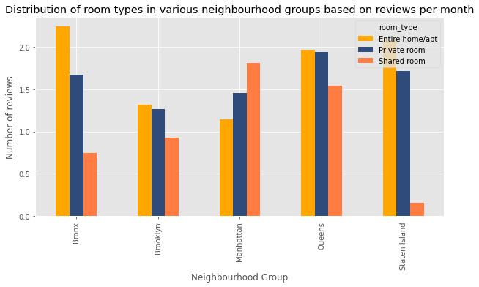
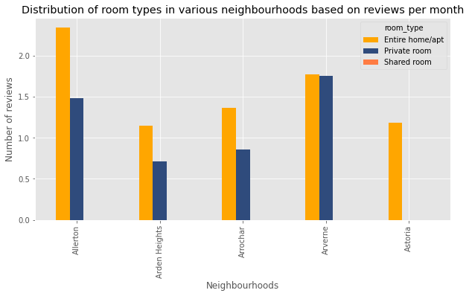
Distribution of room types in various neighbourhood groups, neighbourhoods and their price range based on reviews per month.

Slide 21
Challenges
Dividing the problem statement into sub problems.
Coming up with an overall approach.
Drawing logical conclusions from various operations.
Technical issues due to poor connectivity during group meetings.
Time management.

Slide 22
Conclusion
We philosophized about the variables, we analysed 'Price' alone and with the most correlated variables, we dealt with missing data and outliers, we tested some of the fundamental statistical assumptions and we even transformed categorical variables into dummy variables. That's a lot of work that Python helped us make easier. Now you can take wiser decisions to make your profit or to save your money!

Slide 23
Thank You!

Slide 24
Q & A

